Slide 1
Gameweek 3

Slide 2
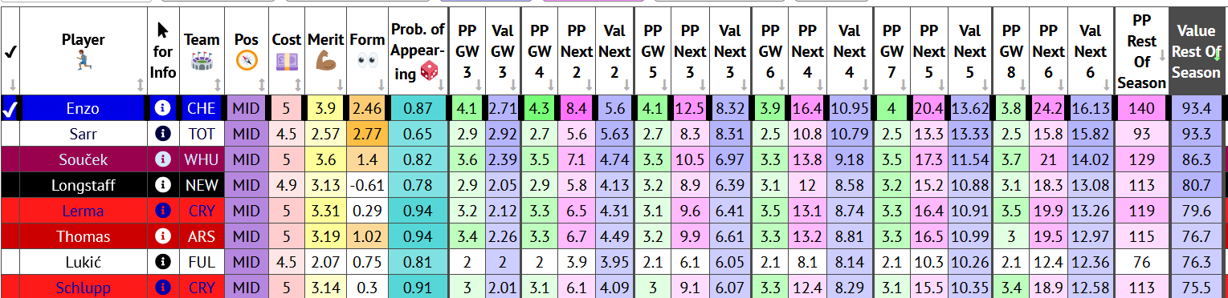
Attacker Data

Slide 3
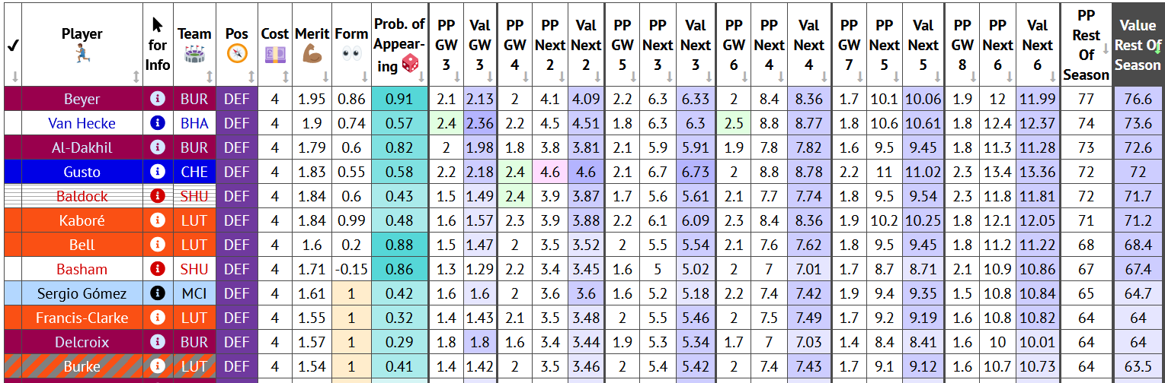
Defender Data

Slide 4
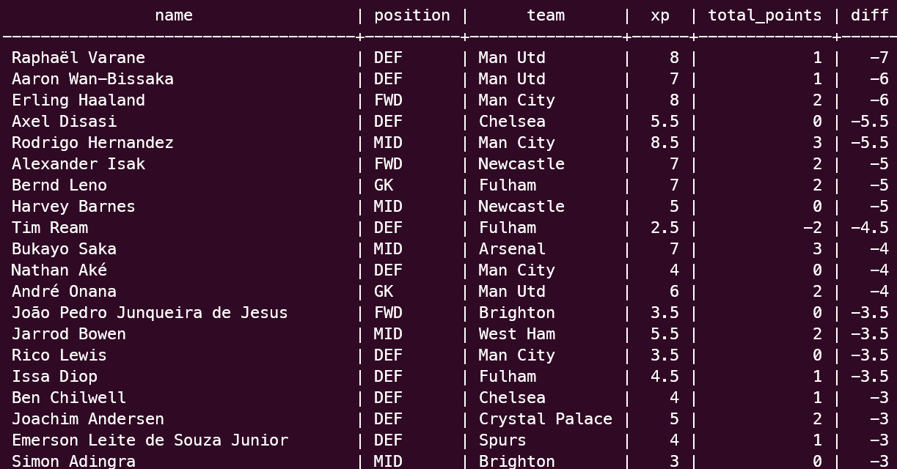
Difference in xP vs total_points (lowest)
Notes:
Sql code
CREATE TABLE gw2 (
name varchar(255),
position char(3) CHECK (position in ('GK', 'DEF', 'MID', 'FWD')),
team varchar(255),
xP float,
total_points integer);
COPY gw2(name, position, team, xP, total_points)
fpl-# FROM '/mnt/c/Users/siyang/Documents/GitHub/data-driven-fpl/23-24-season/gw3/gw2_modified.csv'
fpl-# DELIMITER ','
fpl-# CSV HEADER;

Slide 5
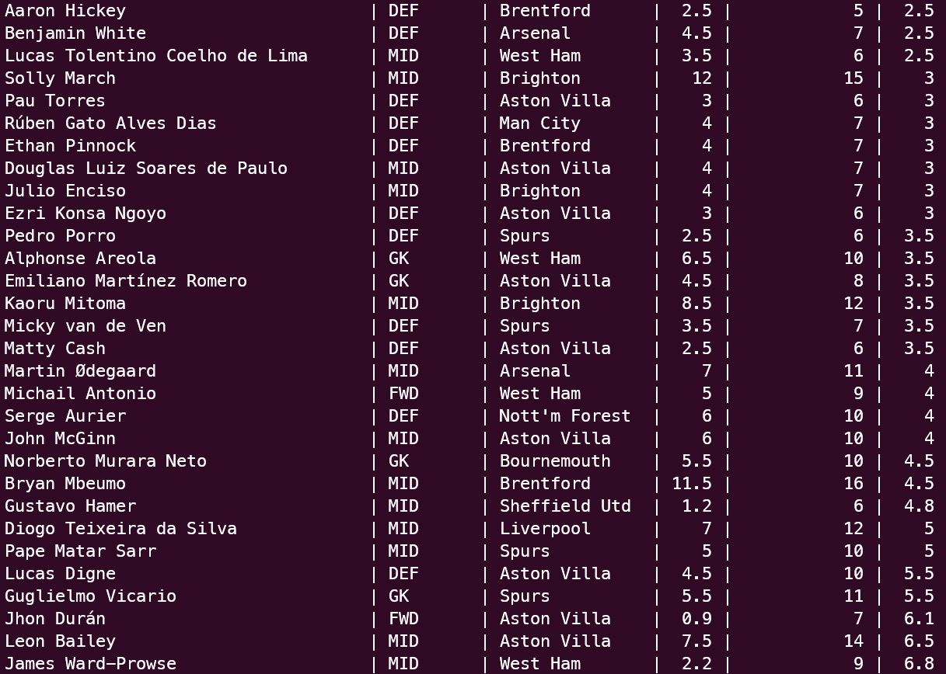
Difference in xP vs total_points (highest)
Notes:
Can see that the most incorrect predictions are usually the ones that just happened to be popular in the week before, while those who are outscoring predictions often are rather unheard of
Sql code:
SELECT *, g.total_points - g.xP AS diff
FROM gw2 g
ORDER BY diff;

Slide 6
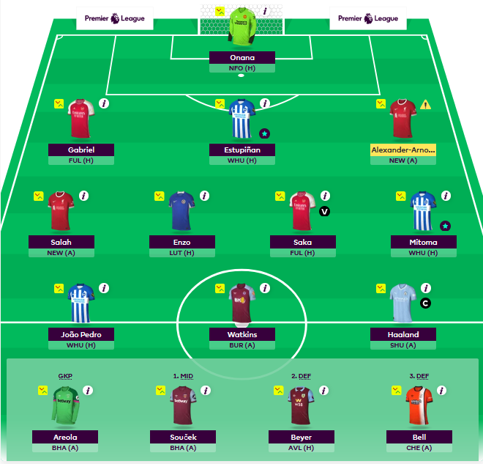
Final Squad
Baldock -> Beyer
Reed -> Enzo
TAA remains on pitch as he is a big game player (?) not very data driven
Soucek benched, harder game than enzo

